Slide 1
Smart City The IOT Project

Slide 2
What is Smart City?
Normal City
In Normal cities people live their lives in bounded environment and do all the normal stuff of their lives manually by themselves or through others.
Generally, there is no automation for any worthless thing and people waste their precious time on the essence care of these small worthless things.
Smart City
In Smart Cities people live standard lives and do all the normal stuff with the help of latest technology trends like machineries, robotics and Information Technologies.
The people of the smart city can focus on their primary objective without taking burden of the worthless stuffs. All the daily normal task are done by the machines.

Slide 3
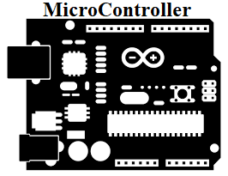
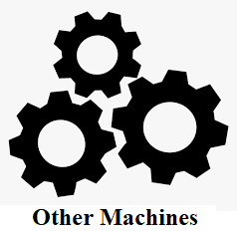
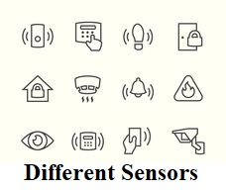

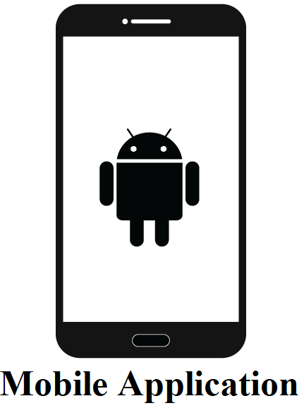

How Smart City Project Works?
Environment
2
1
3
5
5
4

Slide 4
Social Impact of Smart City Project
The Smart City project will give Quality life to the people of city and make their life more easy and convenient.
Using this project people can save their time and electricity and also make their city clean which helps to provide core infrastructure and gives decent quality of life to it's citizens, a clean and sustainable environment.

Slide 5
Technical & Economical Feasibility
Technical Feasibility
Smart city is an IOT project and it will be created using some micro-controllers, some electronic sensors to observe the environment around them and some cloud database to store sensors’ data which is used to program micro-controller to do some specific well defined task as well as it gives real time updates to the application and website.
Economical Feasibility
Automation brings cost saving with AI based and IOT technologies automating city resources such as water, electricity, and saving significant amount of money by doing so and a sustainable ecosystem with reduced emission and cleaner city, greatly increase the standards of living, happiness and leads to economic growth.

Slide 6
Our Services
Smart City Project provide following services
Smart Parking System
Smart Waste Management System
Automatic Street Light System
Smart Water Distribution System
Smart city Project will also provide Mobile Application and Website to the users of city to make them allow to observe the environment around them.

Slide 7
Future Plan
As we know there is no limit that can include in the Smart City.
After completing primary modules we will add some other modules in our project like...
Traffic Management System,
Air Pollution Management,
Smart Irrigation System,
Home Automation System,
Smart Building etc…

Slide 8

THANK YOU

